Slide 1
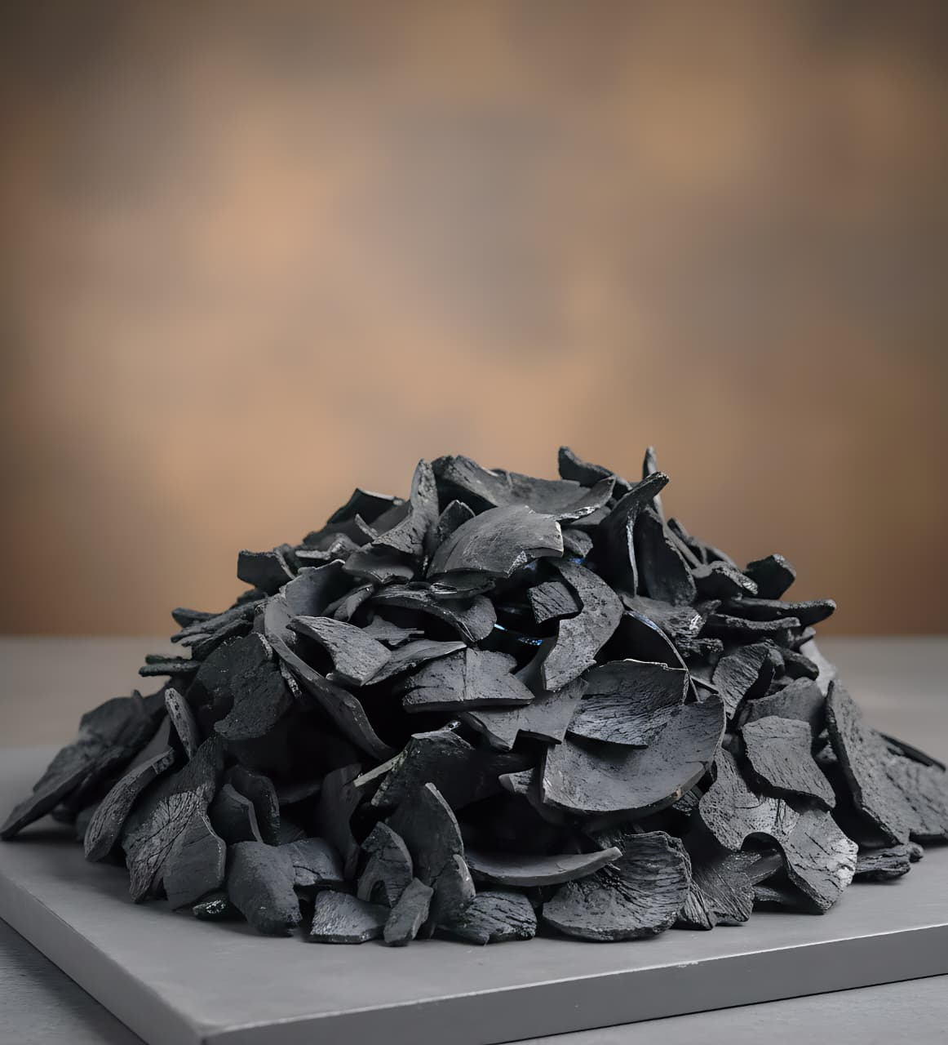
PUTRA PERKASA SEJAHTERA
COMPANY BROCHURE

Slide 2
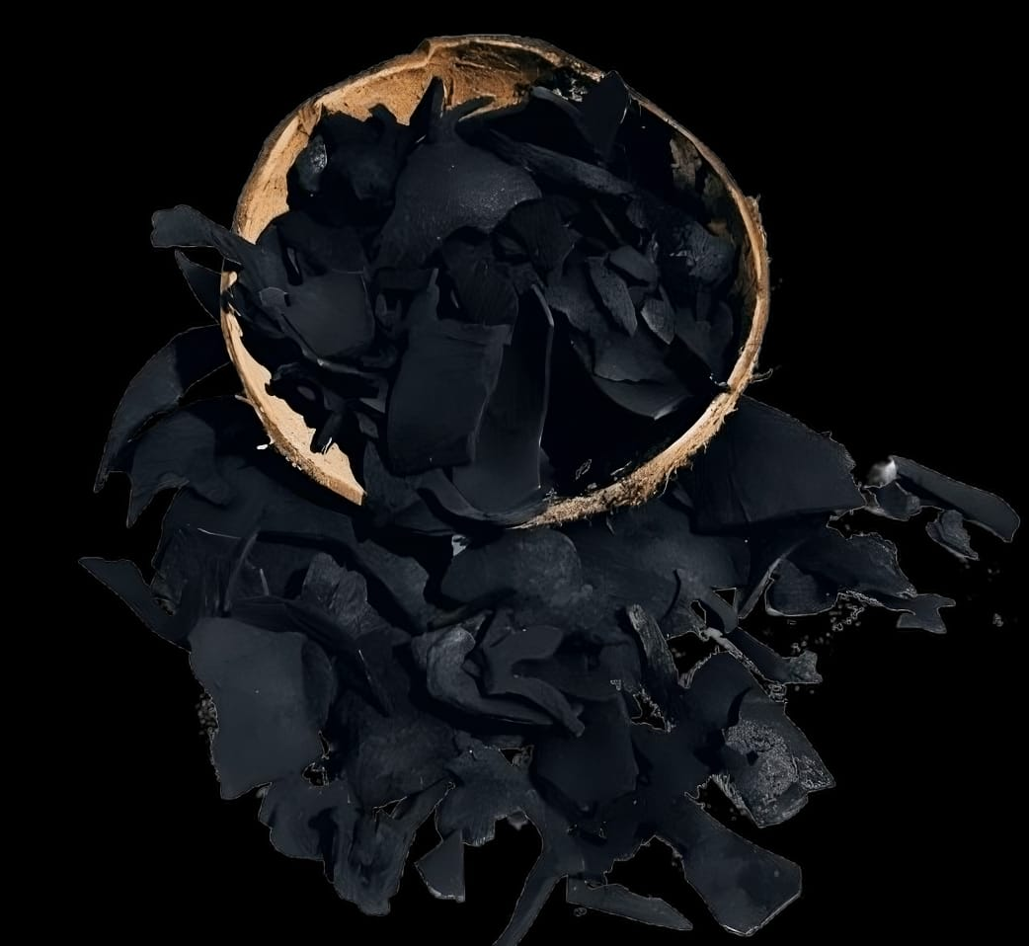


Company Outline
Address
Allegro Office, Komplek Ruko Gateway Waru Blok F27
Waru, Sidaorjo
Jawa Timur
(+62) 813 – 3322 – 8453
(+62) 822 – 2525 - 0082
Andreas@pt-pps.com
Febri@pt-pps.com

Slide 3
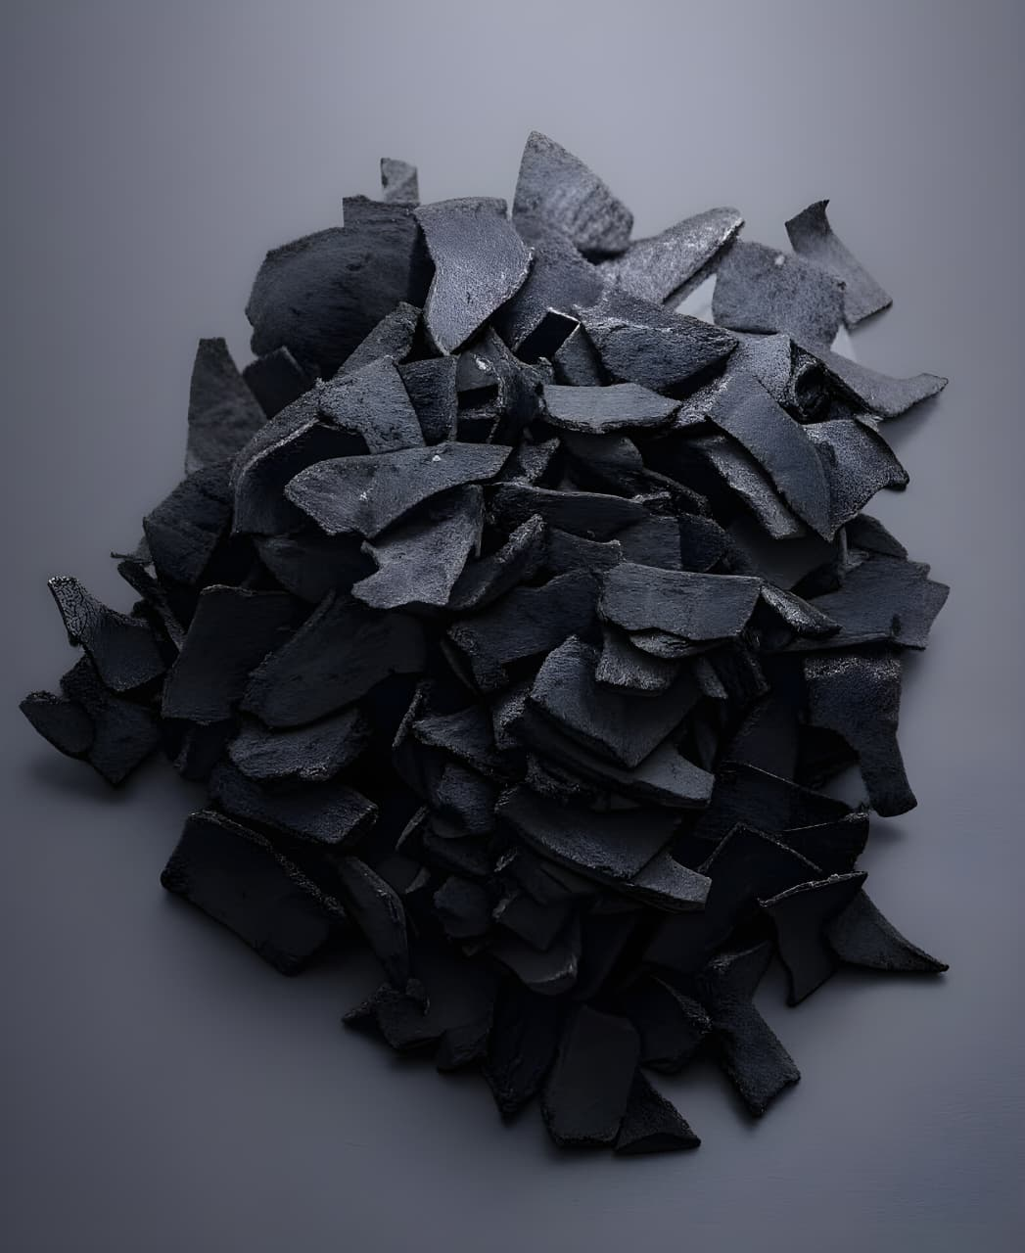
TABLE OF
CONTENTS
1
About Us
2
Mission and Vision
3
Our Comodities
4
Commitment to Excellence

Slide 4
About Us.
Introduction
Established in 2022 and headquartered in Surabaya, Indonesia, Putra Perkasa Sejahtera is engaged in Exporter with commodities COCONUT product especially COCONUT SHELL CHARCOAL. Founded by a team of seasoned engineers and managers with extensive experience in both Indonesian and international industries,
PUTRA PERKASA SEJAHTERA is a dynamic and forward-thinking company dedicated to delivering high-quality services and solutions.
With a strong commitment to innovation, professionalism, and client satisfaction, Putra Perkasa Sejahtera has established itself as a trusted name in the industry
“We are ready to serve customers from various countries and according to their needs”
PUTRA PERKASA SEJAHTERA

Slide 5
Mission & Vision.
OUR MISSION
Fulfill our buyers satisfaction with a product that could be responsible either its quality or its production time.
Collaborating with Workshops / Factories and Educating farmers according to the wishes of the World Market
OUR VISION
To become One of leading COCONUT SHELL CHARCOAL Exporters in Indonesia by Controlling the World Market and paying attention to the Welfare of local Indonesian farmers who work with dedication to build a better future
PUTRA PERKASA SEJAHTERA

Slide 6
Our Comodities
PUTRA PERKASA SEJAHTERA

Slide 7
COCONUT SHELL CHARCOAL
A Brief Explanation of the Production Process for Export-Quality Coconut Shell Charcoal
Producing coconut shell charcoal for export involves a meticulous process to ensure the final product meets high international quality standards. The steps include :
1. Raw Material Selection and Preparation
Collection : Dry and mature coconut shells are gathered from coconuts, ensuring they are free from dirt, impurities, and moisture.
Drying : The shells are thoroughly dried, either naturally under the sun or with a drying machine, to reduce their moisture content. This step is crucial for efficient carbonization.
2. Carbonization
Pyrolysis : The dried coconut shells are heated in a specialized kiln or furnace in a controlled, oxygen-limited environment.
Charring : This process, known as pyrolysis, thermally decomposes the shells, removing moisture and volatile compounds and converting them into pure carbon.
Cooling : After carbonization is complete, the charcoal is left to cool inside the kiln to prevent it from turning into ash due to re-exposure to oxygen.
PUTRA PERKASA SEJAHTERA

Slide 8
COCONUT SHELL CHARCOAL
3. Processing and Quality Control
Crushing and Grinding : The resulting charcoal is crushed and ground into a fine powder.
Sieving : The powder is then sieved to remove excess ash and achieve a consistent mesh size, a critical step for premium-grade products.
Briquetting (Optional) : For charcoal briquettes, the powder is mixed with a natural, eco-friendly binder (like tapioca starch) and pressed into specific shapes and sizes.
Quality Testing : Samples are tested in-house and by independent surveyors for key parameters such as fixed carbon content, ash content, volatile matter, moisture, and calorific value to ensure compliance with export requirements.
4. Packaging and Shipping
Packaging: The charcoal, either in raw or briquette form, is carefully packaged in export-grade materials such as PP bags or sturdy cartons with inner plastic lining.
Container Loading: Charcoal is typically shipped in FCL (Full Container Load) containers via sea freight. Proper palletization and loading techniques are essential to prevent damage during transport.
PUTRA PERKASA SEJAHTERA

Slide 9
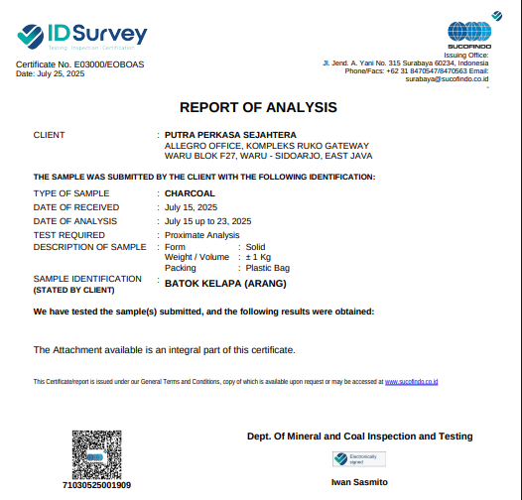
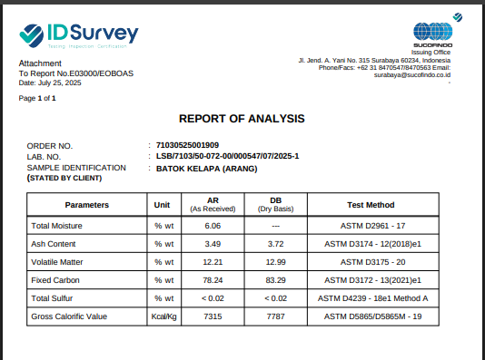
SPECIFICATION
Moisture : 6%
Ash Content : < 4%
Volatile Matter : < 13%
Fixed Carbon : 78% - 83%
Gross Calorific : 7300 - 7700
Packaging : as requested by buyer
PUTRA PERKASA SEJAHTERA

Slide 10
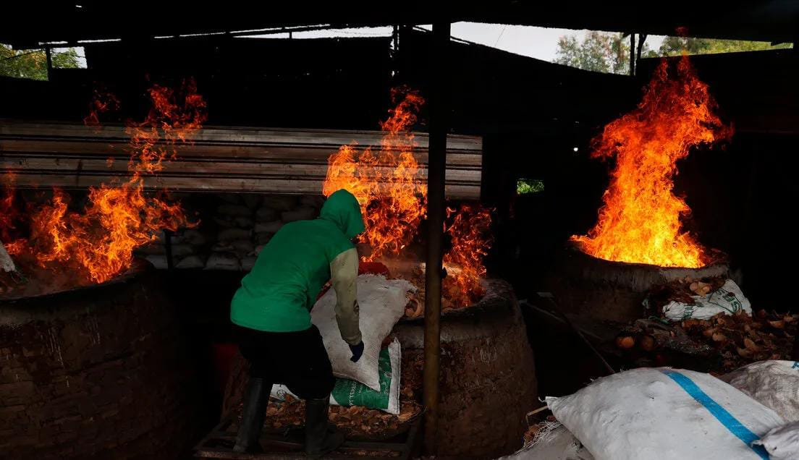
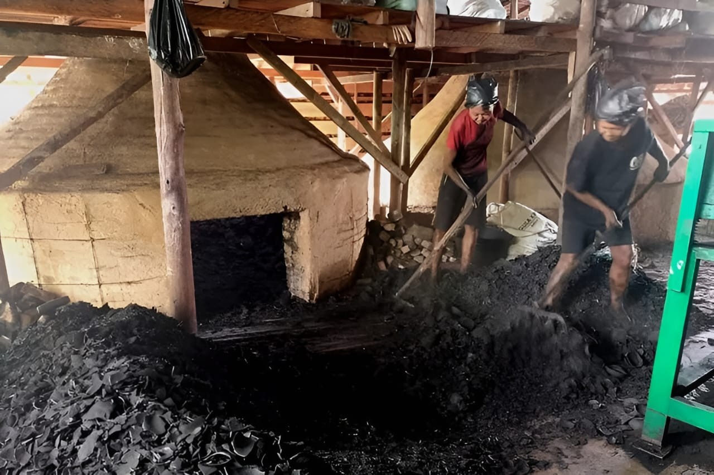
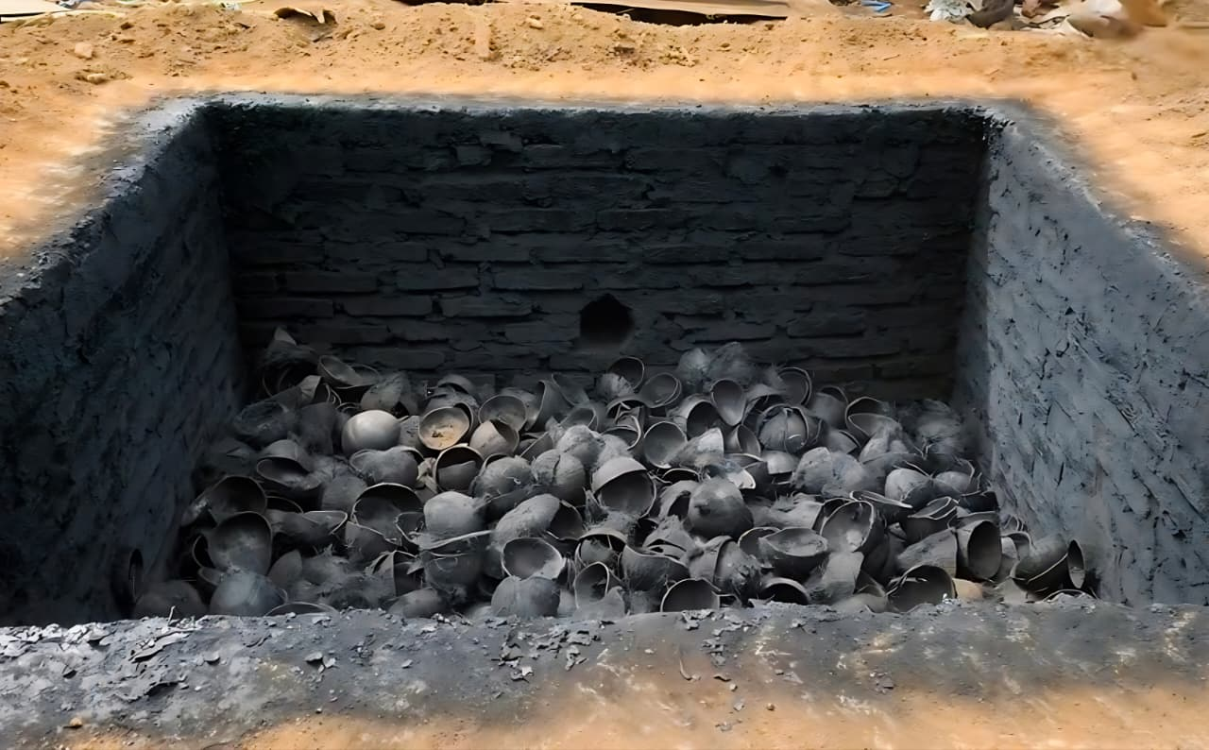
Our
Processing
PUTRA PERKASA SEJAHTERA

Slide 11
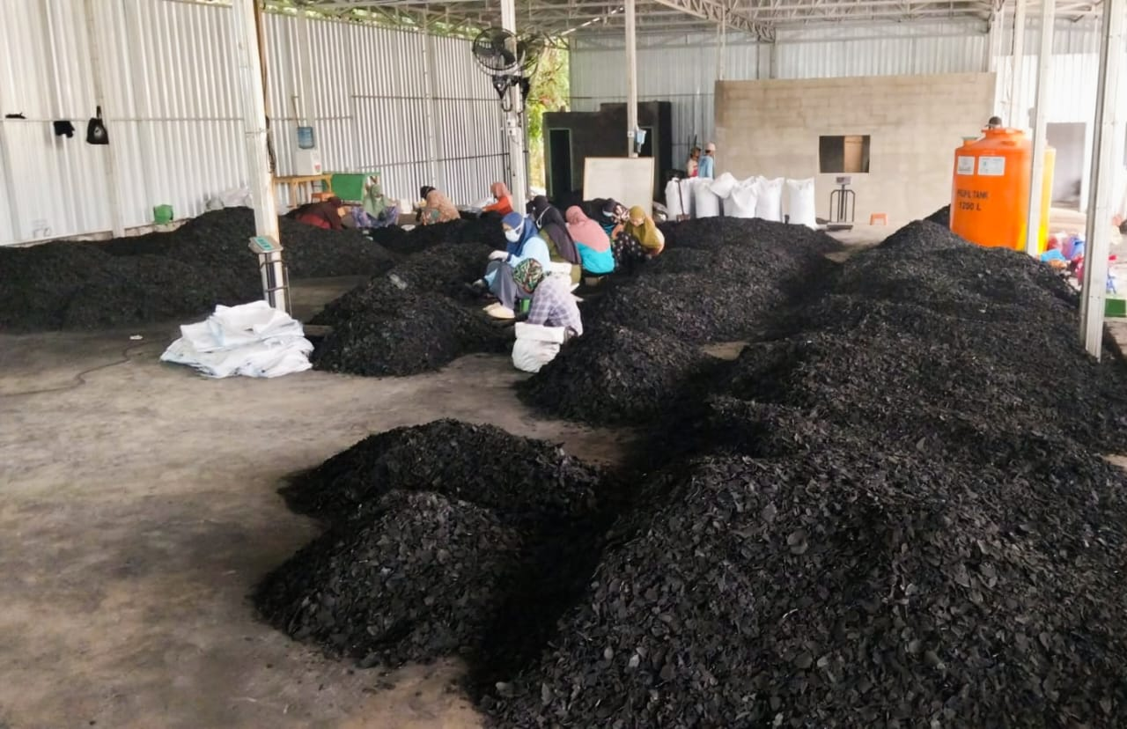
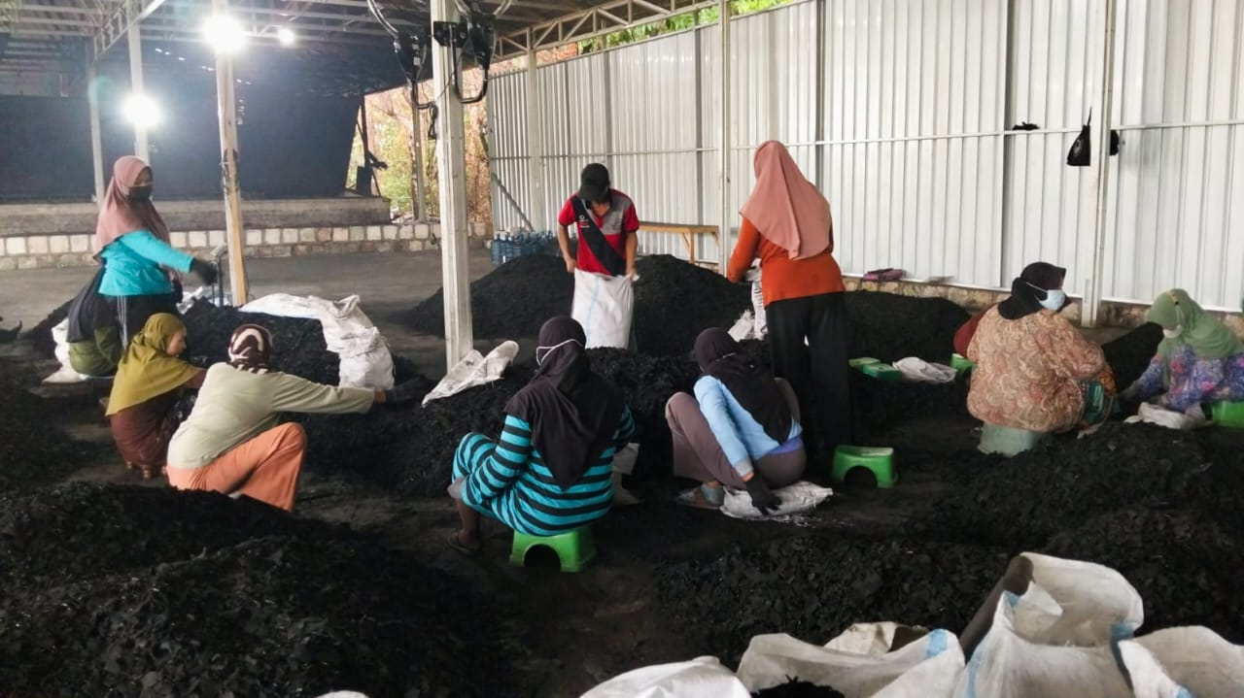
Packaging
PUTRA PERKASA SEJAHTERA

Slide 12
Commitment To Excellence
Putra Perkasa Sejahtera integrates quality, safety, efficiency, and environmental standards into every product. The company's dedicated team leverages their extensive knowledge and experience to continuously enhance service offerings, contributing to a healthier and safer society.
PUTRA PERKASA SEJAHTERA

Slide 13
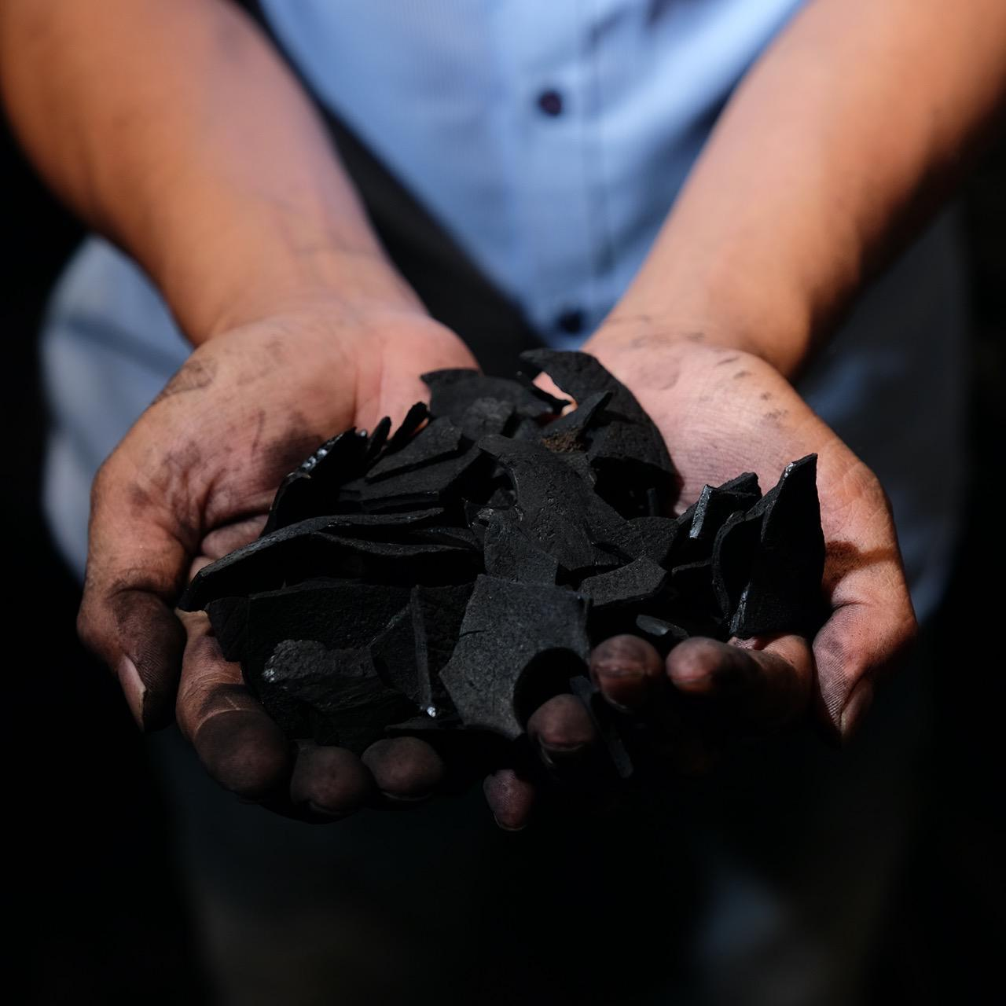
We are eager to provide you with competitive quotations for the activities listed in our field of expertise.
We will be happy to help to match your needs
Yours truly,
Andreas Soekianto.
Febrian Tri Pamungkas
Allegro Office, Komplek Ruko Gateway Waru Blok F27
Waru, Sidaorjo
East Java
(+62) 811 - 3775 – 556 ,
(+62) 822 – 2525 - 0082
Andreas@pt-pps.com
Febri@pt-pps.com

